Slide 1
The Colonies Become New Nations
Ch 34
1945- Present

Slide 2
India
Sec 1

Slide 3
Movement towards independence
By 1945, the British had controlled India for almost 200 years.
During the war, the British tried to gain support from Indian nationalists by promising governmental changes after the war.

Slide 4
Hindus vs Muslims
As the Indians struggled against the British, they also fought amongst themselves.
In the 1940s, there were 350 million Hindus and 100 million Muslims
The Congress Party was the main Hindu political organization
The Muslim League was created to protect Muslim political interests

Slide 5
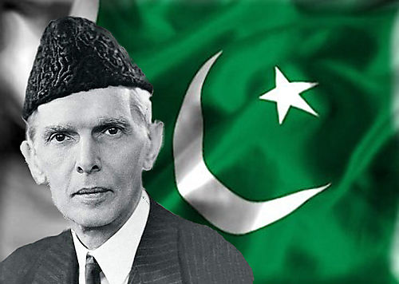
Muslim League
The Muslim League was led by Muhammad Ali Jinnah

Slide 6
Freedom Brings Turmoil
When WW2 ended, the British decided to give India its freedom
The key problem was: Who should receive power, the Muslims or Hindus?
As rioting began to break out the British decided that Partition, division into Hindu and Muslim nations, would be the only way to secure the region

Slide 7
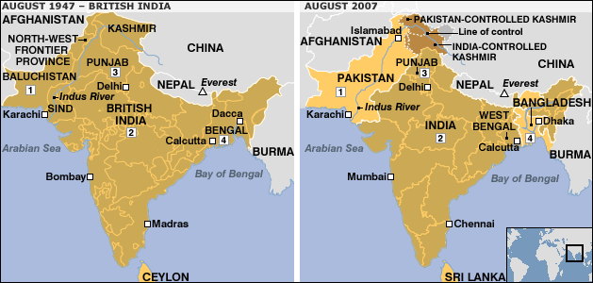

Slide 8
Partition
On July 16, 1947, the British granted India and Pakistan freedom
During the summer of 1947 10 million people were on the move
As people scrambled to relocate violence broke out between the different religious groups.
Approximately 1 million people were killed
The Partition of India and pakistan in color - YouTube

Slide 9
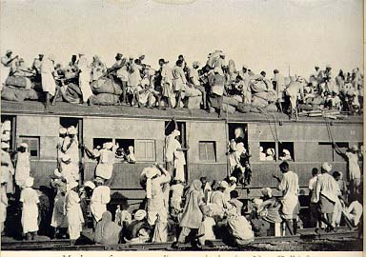

Slide 10
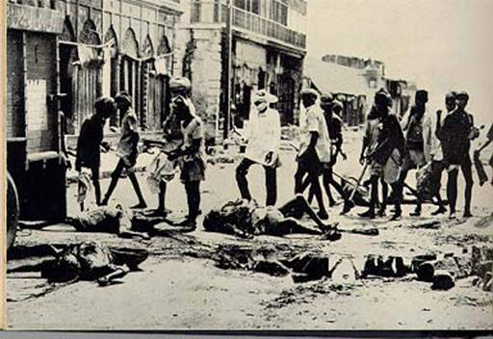

Slide 11
Assassination of Gandhi
While on a trip to Delhi to plead for the fair treatment of Muslim refugees Gandhi was assassinated by a Hindu extremist who thought he was too protective of the Muslims

Slide 12
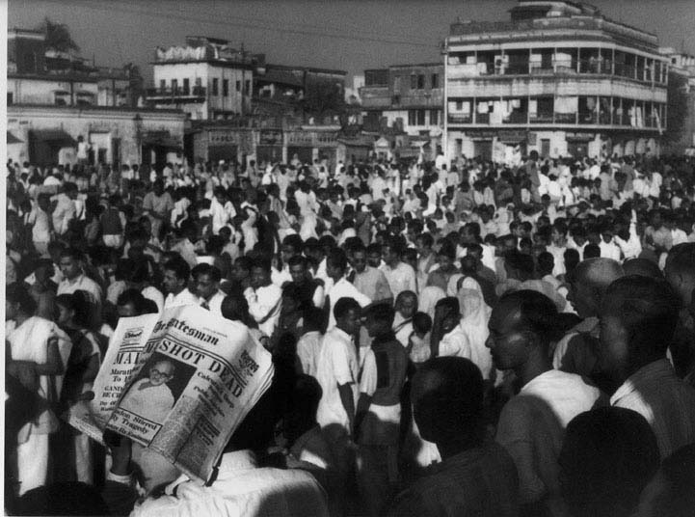

Slide 13
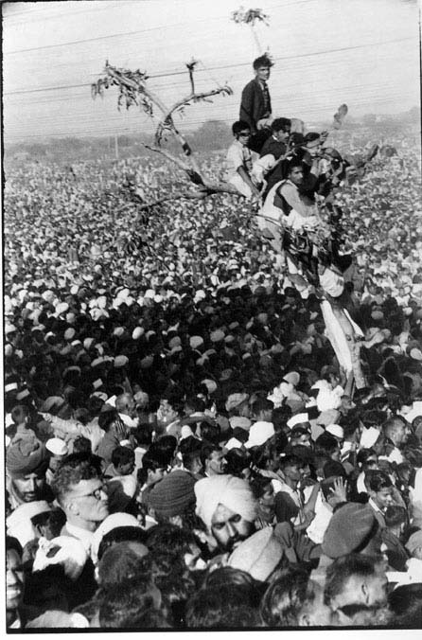

Slide 14
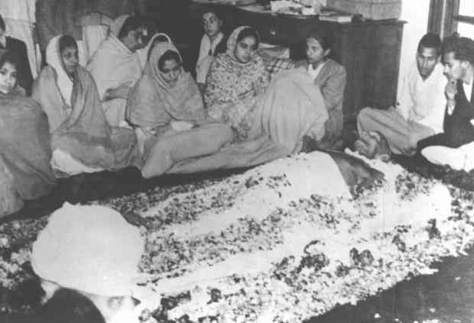

Slide 15
Battle for Kashmir
After the Partition, India and Pakistan began fighting over a region in northern India known as Kashmir
The two countries continue to fight over the region today

Slide 16
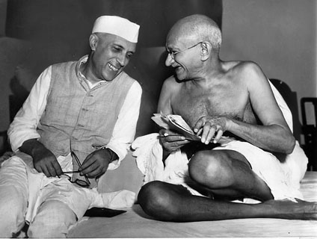
Nehru
After gaining independence, Jawaharal Nehru became the first prime minister of India
His daughter, Indira Gandhi who became prime minister after his death was later assassinated

Slide 17
Modern Problems
India’s growing population is expected to pass China as the world’s most populous nation by 2035
Poverty and religious tension continue to plague the country
Tensions between India and Pakistan are even more troubling now that both countries possess nuclear weapons

Slide 18
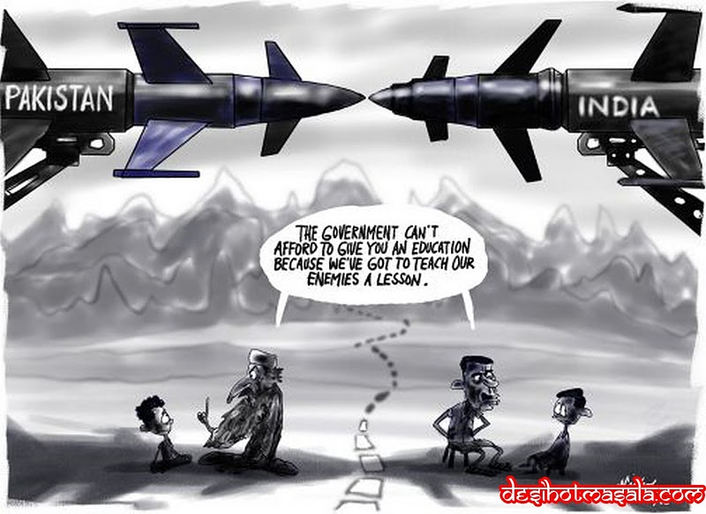

Slide 19
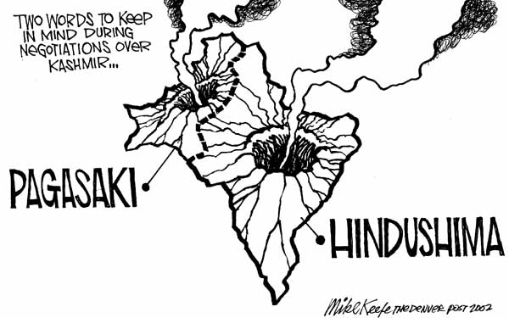

Slide 20
New Nations in Africa

Slide 21
Africa
Imperialism and the Berlin Conference have had long lasting effects on Africa.
As with India and Pakistan, many African nations pushed for their independence after WW2

Slide 22
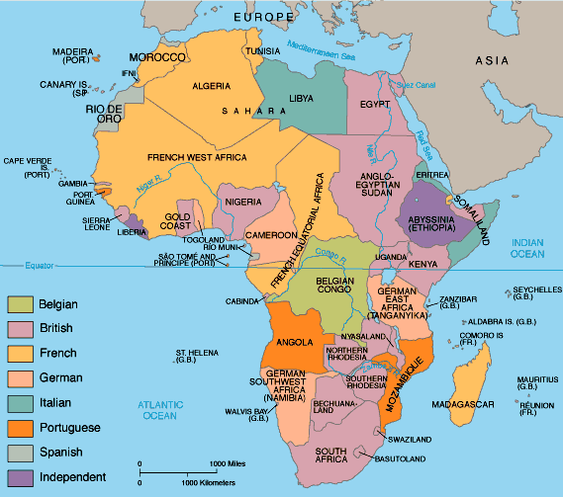

Slide 23
Ghana
The British colony of the Gold Coast was the first colony south of the Sahara to achieve independence
Kwame Nkrumah- nationalist leader who led a nonviolent movement against British rule in the Gold Coast.
Nkrumah became the first prime minister of Ghana
The World Before Us - Dr Kwame Nkrumah (History Channel) - YouTube

Slide 24
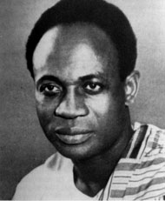

Slide 25
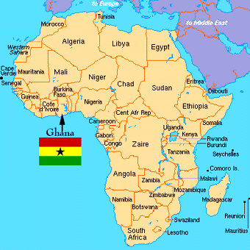

Slide 26
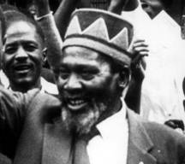
Kenya
Jomo Kenyatta- Kenyan nationalist, first president of Kenya

Slide 27
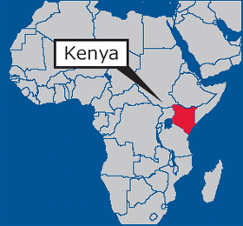

Slide 28
Africa Today
Many civil wars still occur in Africa because of the lasting effects of imperialism and the Berlin Conference
List of conflicts in Africa

Slide 29
Middle East
Sec 4

Slide 30
Israel
The land called Palestine now consists of Israel, the West Bank, and the Gaza Strip
To Jews their claim of the land dates back 3000 years
To Muslim and Christian Palestinians the land has belonged to them since the Jews were driven out around 135 AD
To Arabs the land belongs to them since their conquest in the 7th century

Slide 31
Zionists
Zionists- Jews who returned to their homeland in the late 19th century and early 20th century to recreate their homeland
Balfour Declaration- British efforts to create a Jewish state in Palestine
At the end of WW2, the UN voted to partition Palestine and create a Jewish state
In 1948, the creation of Israel was announced

Slide 32
War
The day after claiming independence Israel was invaded by Egypt, Iraq, Jordan, Lebanon, Saudi Arabia, and Syria
Within months Israel won
War broke out again in 1956, 1967, and 1973

Slide 33
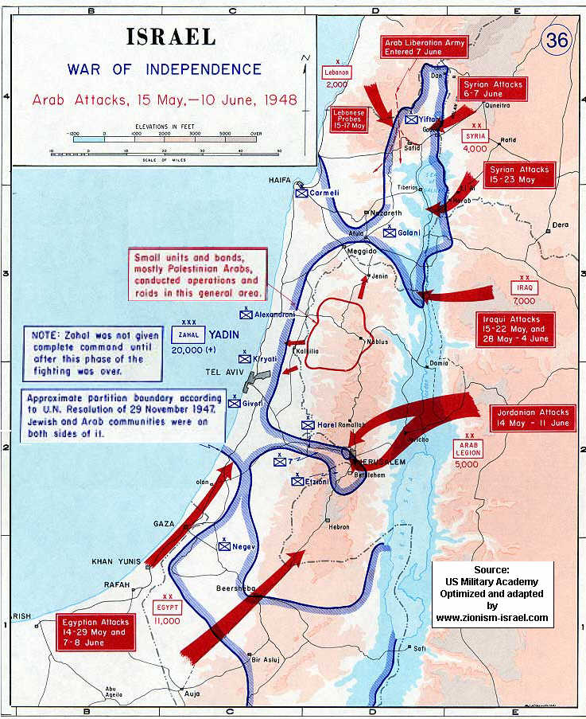

Slide 34
PLO
PLO- Palestinian Liberation Organization, goal is to create an Arab Palestinian state
The PLO carried out many terrorist attacks on Israel in the 1960s and 1970s.
Many peace talks have occurred over the years but tensions remain throughout the Middle East

Slide 35
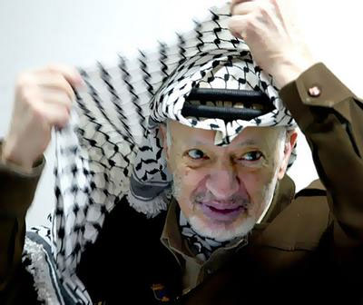

Slide 36
Central Asia Struggles
Sec 5

Slide 37
Collapse of the Soviet Union
When the Soviet Union collapsed in 1991, the republics it conquered emerged as 15 independent nations
Since gaining independence these countries such as Kazakhstan, Uzbekistan, and Turkmenistan have struggled economically
Ethnic and religious tensions are also an obstacle for these new countries

Slide 39
Afghanistan
During the 1800s Russia and Britain fought for Afghanistan but both were unsuccessful
In 1973, military leaders took control of the country and established a communist state
In 1978, opposition forces joined together to form the mujahideen, or holy warriors, who felt communism went against Muslim beliefs

Slide 40
Mujahideen
The Mujahideen used the land, guerilla tactics, and aid from the US to defeat Soviet forces who tried to take control of the country

Slide 41
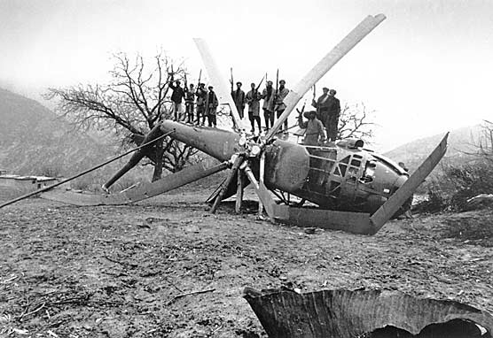

Slide 42
Taliban
With the Soviets gone, the Taliban emerged to take control of the country
The Taliban followed extreme interpretation of Islamic law that affected nearly every aspect of life
Women were forbidden to go to school or hold jobs and TV, radio, movies, and modern music were banned
Punishment included severe beatings, amputation and execution

Slide 43
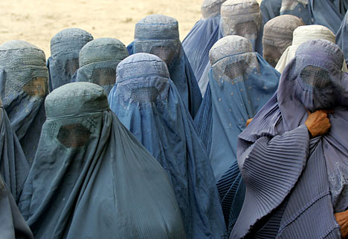

Slide 44
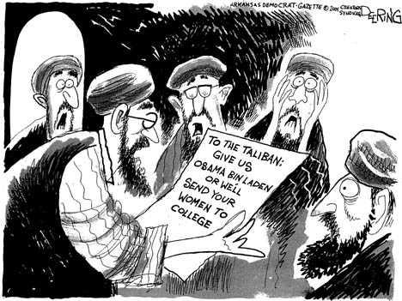

Slide 45
9/11
The Taliban were accused of allowing terrorist groups to train in Afghanistan
They also provided refuge for terrorist leaders including Osama bin Laden
After the September 11th attacks the US demanded the Taliban hand over bin Laden and took military action when they refused

Slide 46
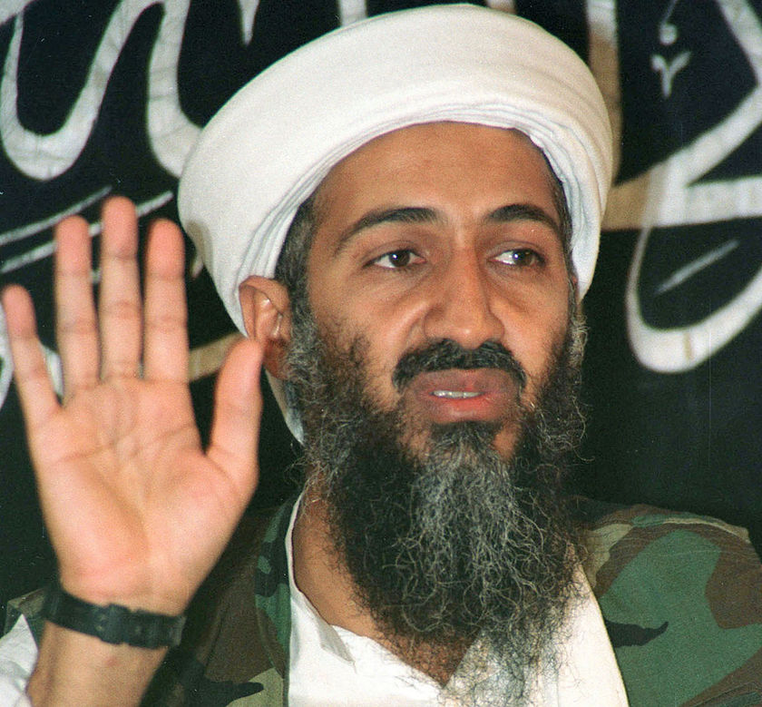

Slide 47
